Slide 1

Business Statistics, 5th ed. by Ken Black
Chapter 9
Statistical Inference: Hypothesis Testing for Single Populations
PowerPoint presentations prepared by Lloyd Jaisingh, Morehead State University

Slide 2
Learning Objectives
Understand the logic of hypothesis testing, and know how to establish null and alternate hypotheses.
Understand Type I and Type II errors.
Know how to implement the HTAB system to test hypotheses.
Test hypotheses about a single population mean when σ is known.
Test hypotheses about a single population mean when σ is unknown.
Test hypotheses about a single population proportion.
Test hypotheses about a single population variance.
Notes:
2

Slide 3
Types of Hypotheses
Research Hypothesis
  a statement of what the researcher believes will be the outcome of an experiment or a study
Statistical Hypotheses
  a formal structure used to scientifically test the research hypothesis
Substantive Hypotheses
  a statistically significant difference does not imply a material, or substantive difference

Slide 4
Example Research Hypotheses
Older workers are more loyal to a company.
Average performance of the students have improved
Proportion of new car purchasers who are female has increased
Companies with more than $1 billion of assets spend a higher percentage of their annual budget on advertising than do companies with less than $1 billion of assets.
Proportion of defective items produced by the company has decreased.

Slide 5
Statistical Hypotheses
Two Parts
  a null hypothesis
  an alternative hypothesis
Null Hypothesis – nothing new is happening; the null condition exists
Alternative Hypothesis – something new is happening
Notation
  null: H₀
  alternative: H_{a}

Slide 6
Null and Alternative Hypotheses
The Null and Alternative Hypotheses are mutually exclusive. Only one of them can be true.
The Null and Alternative Hypotheses are collectively exhaustive. They are stated to include all possibilities.
The Null Hypothesis is assumed to be true.
Notes:
5

Slide 7
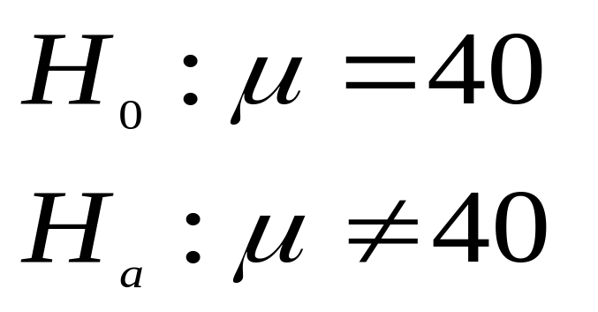
Null and Alternative Hypotheses: Example
A manufacturer is filling 40 grams packages with flour.
The company wants the package contents to average 40 grams.
Notes:
6

Slide 8
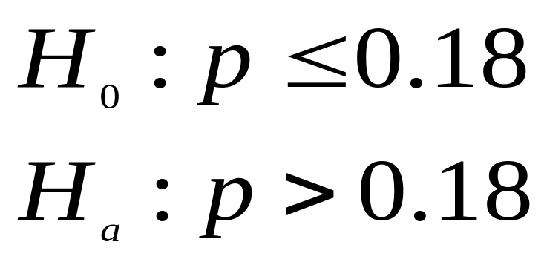
Null and Alternative Hypotheses: Example
Because of an increase marketing effort, company officials believe the company’s market share is now greater than 18%, and the officials would like to prove it.
Notes:
6

Slide 9
HTAB System to Test Hypotheses
Task 1:
HYPOTHESIZE
Task 3:
TAKE STATISTICAL ACTION
Task 2:
TEST
Task 4:
DETERMINING THE
BUSINESS IMPLICATIONS

Slide 10
Rejection and Nonrejection Regions
Using the critical values, the possible statistical outcomes of a study can be divided into two groups:
Those that cause the rejection of the null hypothesis
Those that do not cause the rejection of the null hypothesis

Slide 11
Rejection and Nonrejection Regions
Conceptually and graphically, statistical outcomes that result in the rejection of the null hypothesis lie in what is termed the rejection region.
Statistical outcomes that fail to result in the rejection of the null hypothesis lie in what is termed the nonrejection region.

Slide 12
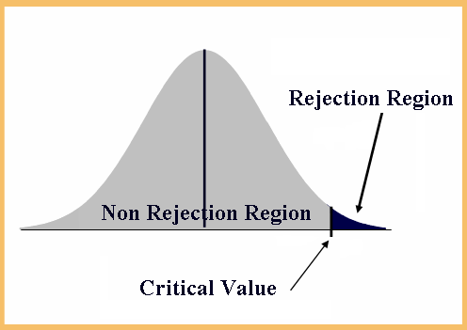
Possible Rejection and Nonrejection Regions -
Rejection region
for hypothesis
which involve the
standard normal
distribution and
the > symbol (right –tailed test)

Slide 13
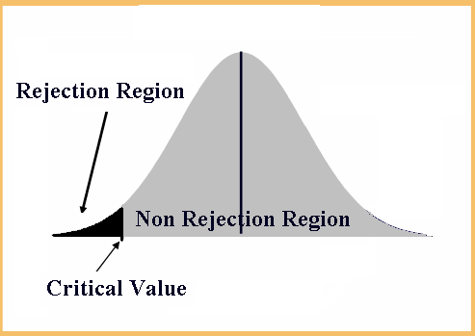
Possible Rejection and Nonrejection Regions -
Rejection region
for hypothesis
which involve the
standard normal
distribution and
the < symbol (left –tailed test)

Slide 14
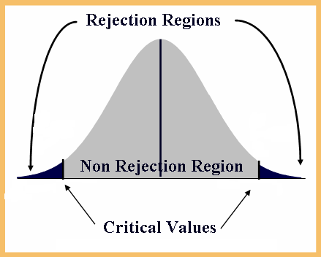
Possible Rejection and Nonrejection Regions -
Rejection region
for hypothesis
which involve the
standard normal
distribution and
the ≠ symbol (two –tailed test)

Slide 15
Type I and Type II Errors
Type I Error
  Rejecting a true null hypothesis
  The probability of committing a Type I error is called α, the level of significance.
Type II Error
  Failing to reject a false null hypothesis
  The probability of committing a Type II error is called β.
Notes:
8

Slide 16
Decision Table for Hypothesis Testing
Null True
Null False
Fail to
Correct
Type II error
reject null
Decision
(
)
β
Reject null
Type I error
Correct Decision
(
)
α
Notes:
9

Slide 17
Testing Hypotheses about a Population Mean Using the z Statistic (σ Known)
Example: A survey, done 10 years ago, of CPAs in the U.S. found that their average salary was $74,914. An accounting researcher would like to test whether this average has changed over the years. A sample of 112 CPAs produced a mean salary of $78,695. Assume that the population standard deviation of salaries σ = $14,530.

Slide 18
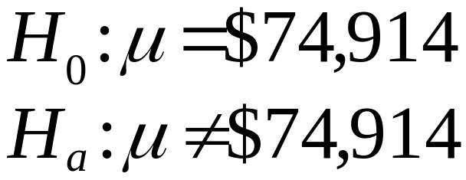
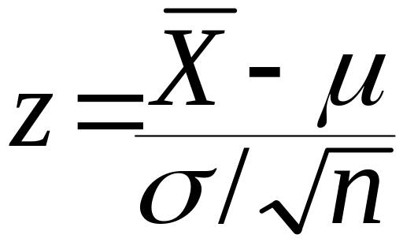
Testing Hypotheses about a Population Mean Using the z Statistic (σ Known)
Step 1: Hypothesize
Step 2: Test

Slide 19
Testing Hypotheses about a Population Mean Using the z Statistic (σ Known)
Step 3: Specify the Type I error rate-
α = 0.05 ⇒ z_{α/2} = ±1.96
Step 4: Establish the decision rule-
Reject H₀ if the test statistic < -1.96 or it the test statistic > 1.96.

Slide 20
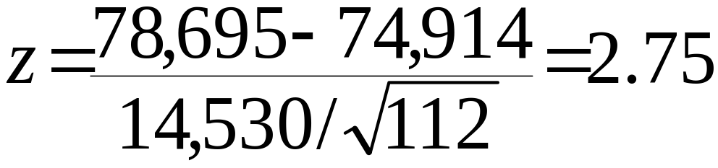
Testing Hypotheses about a Population Mean Using the z Statistic (σ Known)
Step 5: Gather sample data-
x-bar = $78,695, n = 112, σ = $14,530, hypothesized μ = $74,914.
Step 6: Compute the test statistic.

Slide 21
Testing Hypotheses about a Population Mean Using the z Statistic (σ Known)
Step 7: Reach a statistical conclusion-
Since z = 2.75 > 1.96, reject H₀.
Step 8: Business decision-
Statistically, the researcher has enough evidence to reject the figure of $74,914 as the true average salary for CPAs. In addition, based on the evidence gathered, it may suggest that the average has increased over the 10-year period.

Slide 22
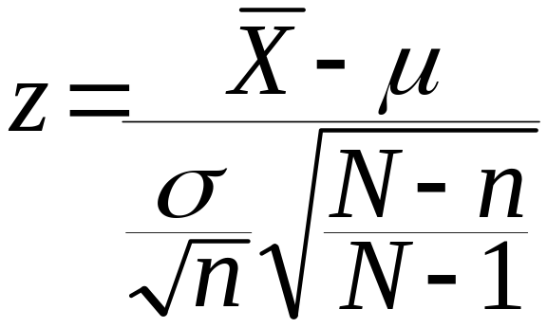
Testing Hypotheses about a Population Mean Using the z Statistic (σ Known) from a Finite Population
Test statistic:

Slide 23
Using the p-Value to Test Hypotheses
Another way to reach a statistical conclusion in hypothesis testing problems is by using the p-value, sometimes referred to as the observed significance level.
p-value < α ⇒ reject H₀
p-value ≥ α ⇒ do not reject H₀

Slide 24
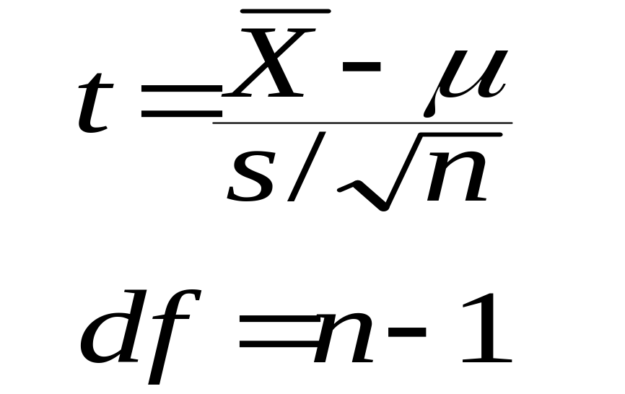
Testing Hypotheses about a Population Mean Using the t Statistic (σ Unknown)
In this case, the test statistic will be
Follows the t-distribution with (n-1) degree of freedom

Slide 25
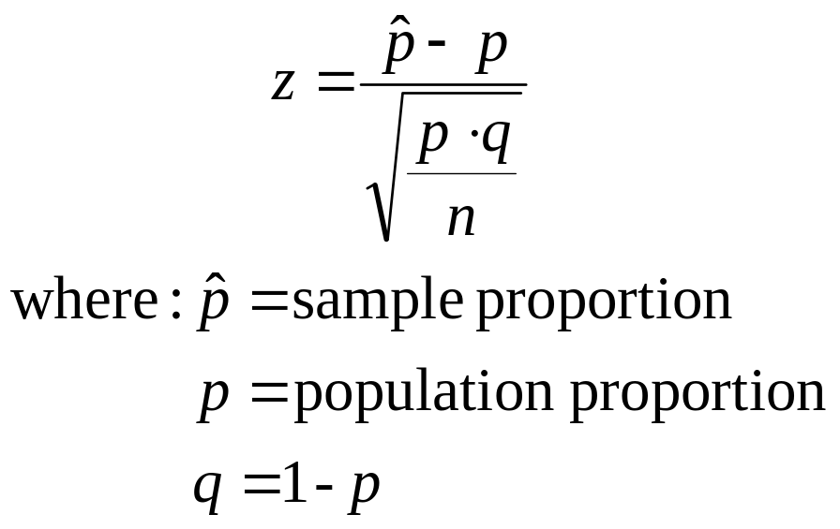
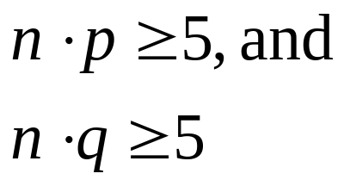
z Test of Population Proportion
Notes:
28

Slide 26
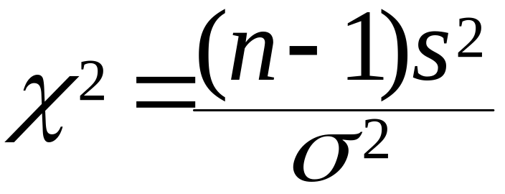
Testing Hypotheses About a Variance
The test statistic for this test is
Follows the Chi-Square distribution with (n-1) degree of freedom

